Slide 1
Key dates
Outline:
Day, Date, Time
Final storyboard:
Day, Date, Time
Name (email)
Name (email)
Final Script: / Final TT with Thumbnails
Day, Date, Time
Recording:
Day
Date
Time Location
Name (email)
Name (email)
Name (email)
Name (email)
Airing of Final Video:
Tuesday, November 2, 5pm
Notes:
Vis Comm key dates

Slide 2
Microsoft Ignite

Slide 3
Code of Conduct
Microsoft’s mission is to empower every person and every organization on the planet to achieve more. This includes all Microsoft events and gatherings, including on digital platforms, where we seek to create a respectful, friendly, fun and inclusive experience for all participants. We expect all digital event participants to uphold the principles of this Code of Conduct, which covers the main digital event and all related activities. We do not tolerate disruptive or disrespectful behavior, messages, images, or interactions by any party participant, in any form, at any aspect of the program including business and social activities, regardless of location.
Microsoft will not tolerate harassment or discrimination based on age, ancestry, color, gender identity or expression, national origin, physical or mental disability, religion, sexual orientation, or any other characteristic protected by applicable local laws, regulations, and ordinances. We encourage everyone to assist in creating a welcoming and safe environment. Please report any concerns, harassing behavior, suspicious, or disruptive activity to Business Conduct Hotline (1-877-320-MSFT or buscond@microsoft.com). Microsoft reserves the right to refuse admittance to or remove any person from Microsoft events.

Slide 4
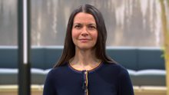
Secure, develop, and innovate in hybrid and multicloud with Microsoft Azure
BRK210 - Roanne Sones

Slide 5
Video
BRK210

Slide 6
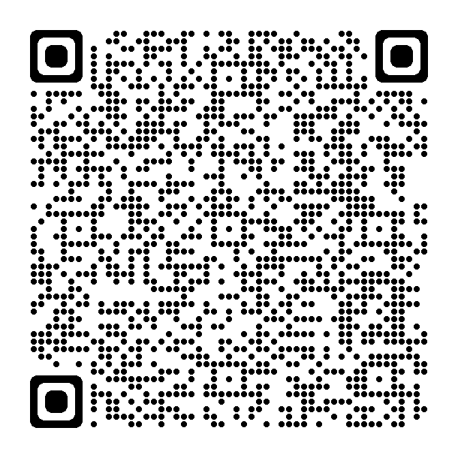
Please fill in the survey
Microsoft Ignite: After Party Feedback (office.com)

Slide 7
aka.ms/PostIgnite
Discover additional learning resources, technical content and upcoming events through January 2022, such as:
Custom Learn Collections
On-Demand Content from Ignite
Learn Live Series (through Dec. 16)
Ask the Expert Show (through Dec. 17)
Community-led Table Talks (week of Nov. 15)
Cloud Skills Challenge (open until Nov. 30)

Slide 8
Closing

